Slide 1






AMAZON DEMAND FORECASTING PROJECT: DATA PREPARATION AND ANALYSIS
Priscal Ososeilu Isele
133598

Slide 2
CONTENT
Overview
Data Collection
Data Preprocessing - Categorical Data Encoding
Feature Engineering - New Features
Data Integrity and Quality Assessment
Exploratory Data Analysis (EDA) Overview
1
2
3
4
5
6
7
8
9
10
11
12
Data Sources
Data Cleaning – Initial Steps
Data Transformation - Numerical Scaling
Data Integration
Ethical Considerations
Summary and Next Steps

Slide 3

PROJECT OVERVIEW
The purpose of this project is to improve Amazon’s ability to forecast demand for products by creating a refined, structured dataset that can provide accurate insights.
This demand forecasting will help Amazon optimize inventory, reduce costs, and improve customer satisfaction by minimizing stockouts and overstock.

Slide 4

Project Overview: Business Significance
Demand forecasting is crucial for efficient logistics, reducing operational costs, and improving customer experience, as Amazon’s logistics rely heavily on accurate predictions to maintain a competitive edge in e-commerce.

Slide 5

Project Overview: Agenda
Data collection
Data cleaning
Preprocessing
Feature engineering
Data quality assessments

Slide 6
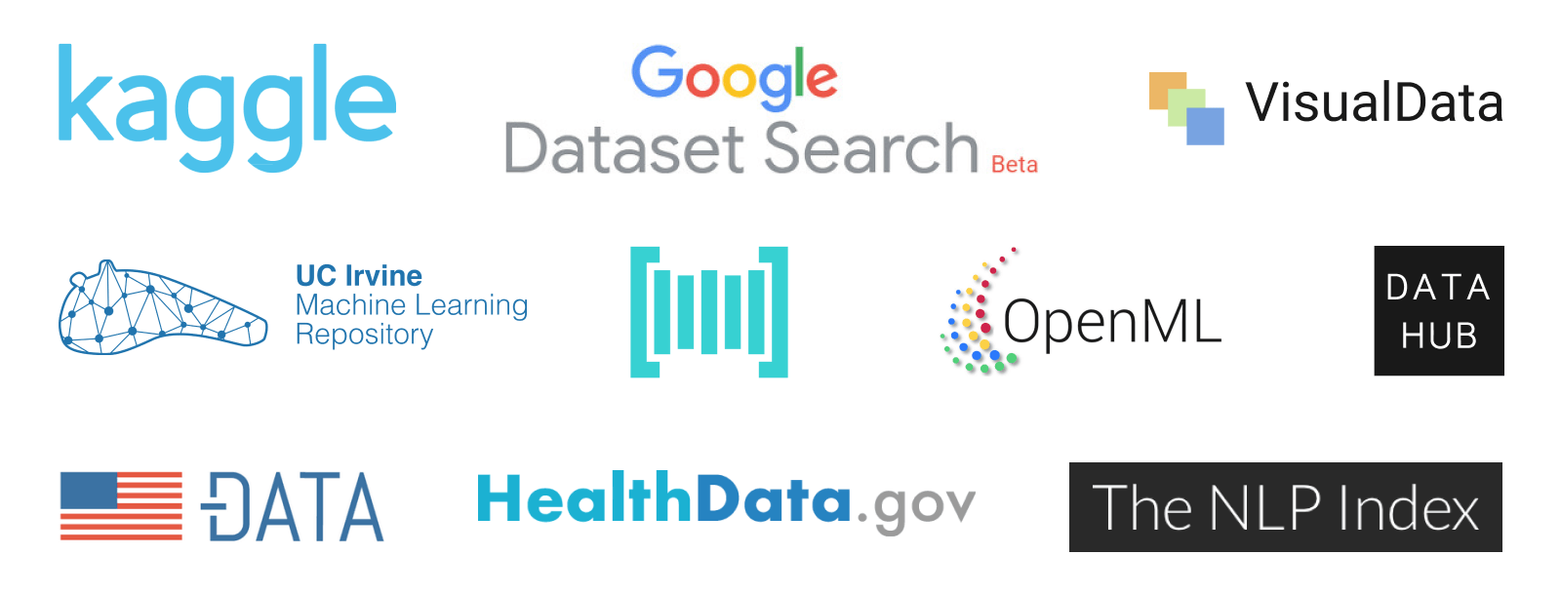
DATA SOURCES: OVERVIEW
The data was sourced from a publicly available dataset representing Amazon’s customer purchases, including demographic details, product IDs, and purchase history. Data similar to this can be found on platforms like Kaggle or Amazon’s public datasets.

Slide 7
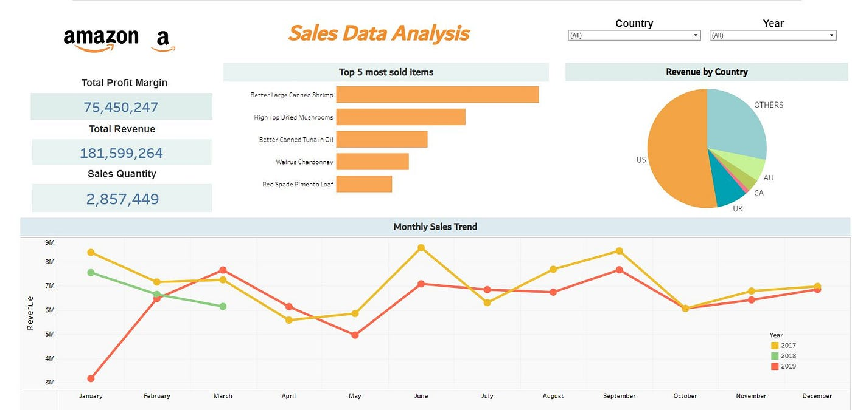
SOURCE TYPE AND COLLECTION METHODS
Amazon Sales Data: Includes variables such as User ID, Product ID, Age, City Category, Purchase Amount, etc.
External Data Sources: Potentially integrating external economic data, seasonal data (holidays, peak periods).

Slide 8


TOOLS FOR COLLECTION
SQL: Used to query structured databases.
Python Libraries: Pandas for data manipulation, requests or APIs for real-time data (if applicable).

Slide 9

DATA SOURCES: CHALLENGES
Ensuring data privacy, compatibility, and legal considerations are addressed when collecting and integrating multiple datasets.

Slide 10









DATA COLLECTION PROCESS

Slide 11

_{DATA EXTRACTION TECHNIQUES}
Data pulled from Amazon’s internal structured databases.
Potentially external data sources to enhance predictive capability (e.g., seasonal data for peak demand).

Slide 12


DATA COLLECTION PROCESS: TOOLS USED
SQL for Database Extraction: Ideal for querying and pulling structured sales data.
Python Scripting: For automated collection and preliminary analysis.
APIs/Web Scraping (when allowed): To capture supplementary data.

Slide 13

CHALLENGES IN DATA COLLECTION
Data access limitations,
Managing large datasets
Ensuring GDPR compliance
And ethical data usage.

Slide 14
DATA CLEANING - INITIAL STEPS
Objective: Clean the data to improve its quality, ensuring accuracy and usability

Slide 15

KEY CLEANING ACTIONS
Handling Missing Values: Missing data in columns like Age or Purchase can be addressed through imputation (mean or median for continuous data) or by removing rows with missing values where necessary.
Removing Duplicates: Ensure each transaction or record is unique to prevent duplicate data from skewing the forecast.
Standardizing Categories: Ensure categorical data, like City_Category and Gender, follow a consistent format.

Slide 16

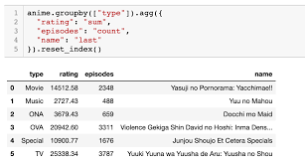
_{TOOLS USED}
Python’s Pandas library is highly effective for data cleaning operations like handling missing values, removing duplicates, and reformatting columns.

Slide 17
DATA PREPROCESSING – CATEGORICAL DATA ENCODING
Objectives: Convert categorical data into a format suitable for machine learning models

Slide 18
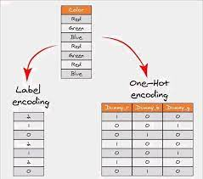
ENCODING TECHNIQUES
Label Encoding: Used for binary categorical features such as Gender.
One-Hot Encoding: Used for multi-class categorical features like City_Category to avoid numeric bias in the model.

Slide 19

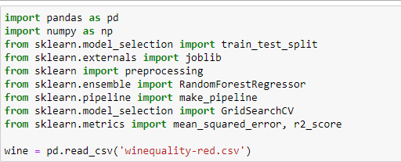
PYTHON TOOLS & EXAMPLE
Scikit-learn provides LabelEncoder and OneHotEncoder for efficient encoding of categorical data.
Example: A column showing City_Category transformed into binary columns (e.g., City_A, City_B, City_C), illustrating how data is represented after encoding.

Slide 20
DATA TRANSFORMATION

Slide 21

PURPOSE OF DATA TRANSFORMATION
Scale features to ensure that all variables contribute equally to the model, preventing features with larger ranges from dominating.

Slide 22
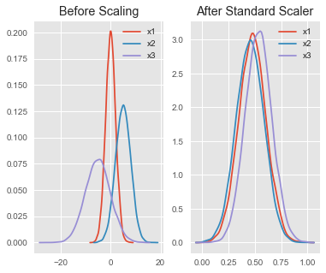
NUMERICAL SCALING: TECHNIQUES, TOOLS
Standardization: Centers data around the mean with a unit standard deviation, useful for continuous variables like Purchase.
Normalization: Scales data within a specific range (e.g., 0 to 1) using Min-Max scaling, suitable for features like Product_Category.
Tools: Scikit-learn’s StandardScaler and MinMaxScaler.

Slide 23
Feature Engineering
Objective: enhance model performance by creating new variables that capture additional pattern in the data

Slide 24

EXAMPLES & TOOLS
Customer Segmentation: Grouping Age into bins to simplify age patterns.
Purchase Behavior by City: Feature to capture how demand varies across cities.
Time-based Features: Seasonal features capturing peak purchase times (e.g., holiday season, back-to-school period).
Pandas in Python is flexible for creating new features from existing ones.

Slide 25
DATA INTEGRATION
Objective: Combine multiple datasets into a unified, coherent dataset.

Slide 26
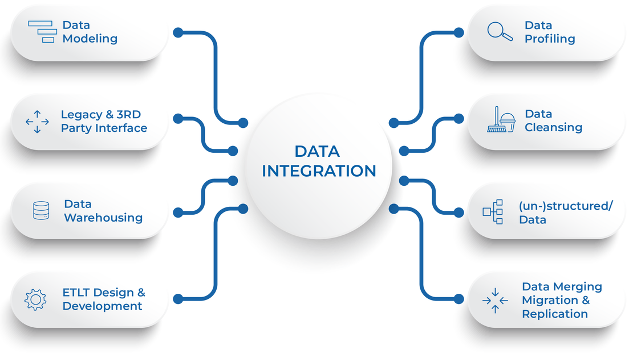
STEPS & CHALLENGES
Dataset Merging: Merge datasets on common keys, such as Product_ID and User_ID.
Compatibility Checks: Ensure that data types and column formats align between datasets.
Challenges: Address potential mismatches, handle missing data from different sources, and ensure correct alignment of time-series data if applicable.

Slide 27
DATA INTEGRITY AND QUALITY ASSESSMENT
Objective: Validate that the data is accurate, complete, and ready for analysis.

Slide 28
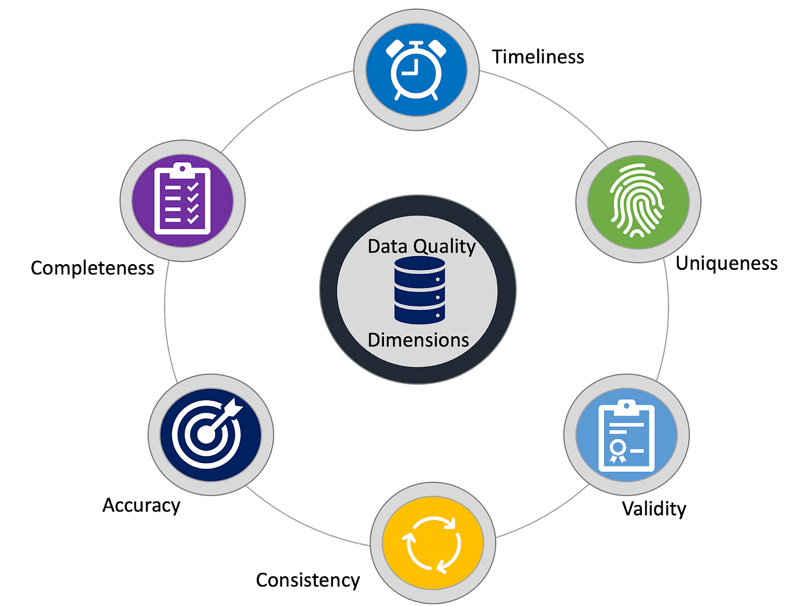
DATA QUALITY CHECKS
Accuracy: Checking that each column contains relevant and correct information.
Completeness: Ensuring no critical data is missing, especially in essential columns.
Consistency: Ensuring no conflicting values (e.g., Age should not conflict with Occupation).

Slide 29
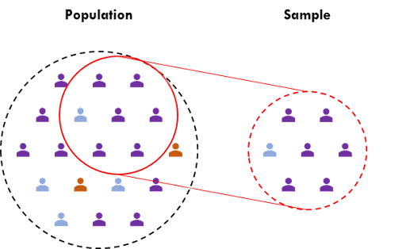
BIAS ASSESSMENT
Check for demographic bias, such as over- or under-representation of specific groups.

Slide 30

ETHICS IN DATA QUALITY CHECKS
Ensure that no individual’s data could lead to privacy concerns, especially when merging external data.

Slide 31
ETHICAL CONSIDERATIONS
Objective: Validate that the data is accurate, complete, and ready for analysis.

Slide 32
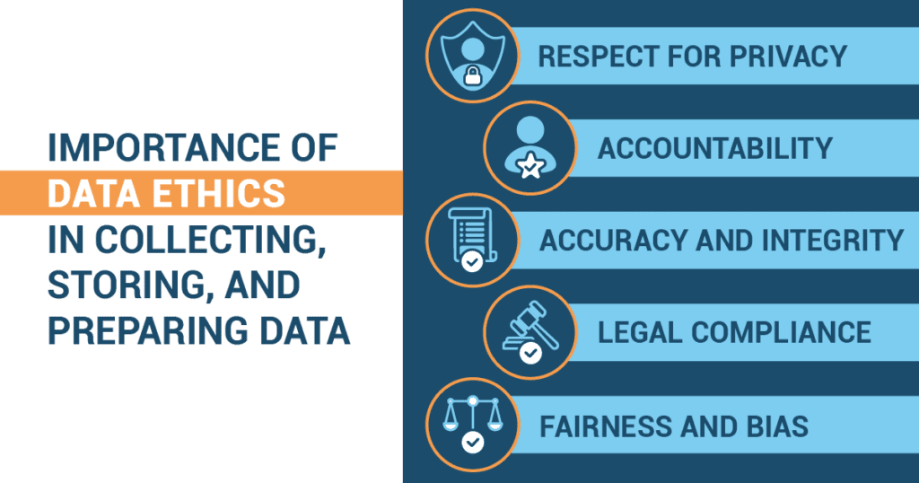
ETHICAL CONSIDERATIONS
Privacy: Data privacy measures are taken to ensure that user data is anonymized or aggregated, maintaining confidentiality.
Bias Mitigation: Ensure that demand forecasting isn’t skewed towards certain demographics due to inherent data bias.
Transparency: Ensuring transparency in the usage and purpose of data in demand forecasting to build trust.
Regulations: Adherence to GDPR or CCPA if applicable.

Slide 33
EXPLORATORY DATA ANALYSIS (EDA) OVERVIEW
Objective of EDA: Discover patterns in the data, validate assumptions, and gain insights

Slide 34
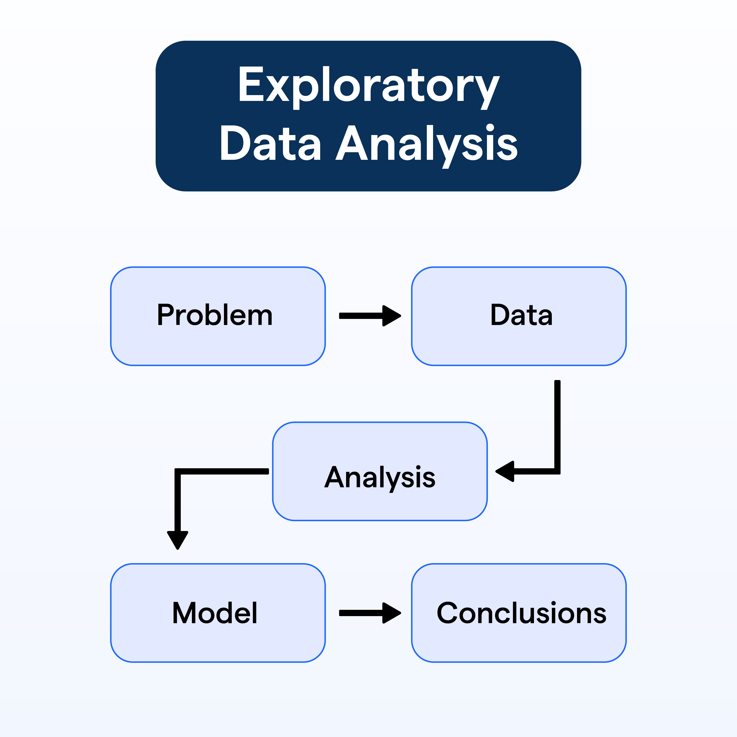
INSIGHTS
Popular Product Categories: Identify products with high purchase volumes.
Demographic Trends: Explore buying behavior by age, gender, and city category.
Seasonal Patterns: Recognize peaks during holiday seasons.

Slide 35

EXPLORATORY DATA ANALYSIS (EDA) OVERVIEW
Tools: Visuals created with Pandas, Matplotlib, and Seaborn in Python.

Slide 36
SUMMARY AND NEXT STEPS
Overview of the data preparation process, covering data collection, preprocessing, transformation, and feature engineering.

Slide 37
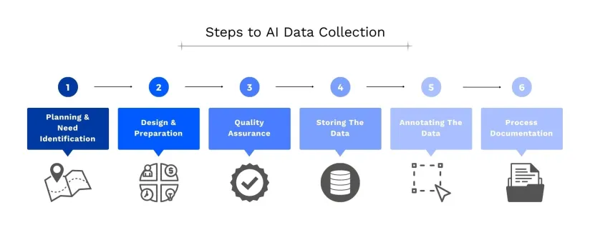
SUMMARY AND NEXT STEPS
Next Steps:
Finalize dataset.
Train predictive models on this cleaned and prepared dataset.
Apply ongoing quality checks as new data is incorporated.

Slide 38

Thank You!

